Slide 1
Kata Dojo Workshop
Story Board Forms
Print out one set of forms for each Story Board.
Use A4 landscape, single page, one side, color print out and fix each set by a paper-clip.
Fill in dates where required.
fold along this line
Story Board
Focus Process _______________
KATA Jet

Slide 2
Next Target Condition
KATA Jet
Process:
Achieve-by Date:
Termin:
Tim
Amy
Improver:
Coach:
Challenge:
Achieve 100% hit rate without changing the target position within 6 month.
Current Condition
Target Condition
hit rate = 20% (1 of 5)
hit rate = 40% (2 of 5)
Outcome Metric:
Outcome Metric:
Process Metric:
Process Metric:
flight distance = 200 cm ± 80 cm
flight distance = 200 cm ± 20 cm
Initial Process-Parameters / Initial Process Pattern
Constraints / Target Process-Parameters / Target Process Pattern
distance to target = 200 cm
distance to target = 200 cm
design changes = 0
budget = 500,- $
flight distance = 200 cm ± 80 cm
flight distance = 200 cm ± 20 cm
Focus
cross deviation = ± 82 cm
cross deviation = ± 20 cm

Slide 3
Current Condition of Outcome Metric
KATA Jet
Process:
Termin:
Indicator (name + unit):
HIT RATE (hits per lot ÷ lot size; lot size = 5)
Remarks
100%
80%
60%
40%
20%
Date

Slide 4
Current Condition of Process Metric
KATA Jet
Process:
Termin:
Indicator (name + unit):
FLIGHT DISTANCE (cm)
Remarks
400
300
200
100
Date

Slide 5
Experimenting Record
KATA Jet
Process:
Termin:
Date
Curr.-Cond. (Process-Ind.)
The 1 Obstacle
(Impact on P-Ind.)
Next Step and Expectation
(numerical data)
until when
What we have learned
(numerical data)
E:
E:
E:
Conduct Experiment
E:
E:
E:

Slide 6
Obstacle Parking Lot
Date
Obstacle

Slide 7
Process Overview
KATA Jet
Process:
Observation date:
Observer:
Tim
distance to target = 200 cm
side view
40 cm
flight distance
target
top view
cross deviation (+)
cross deviation (-)

Slide 8
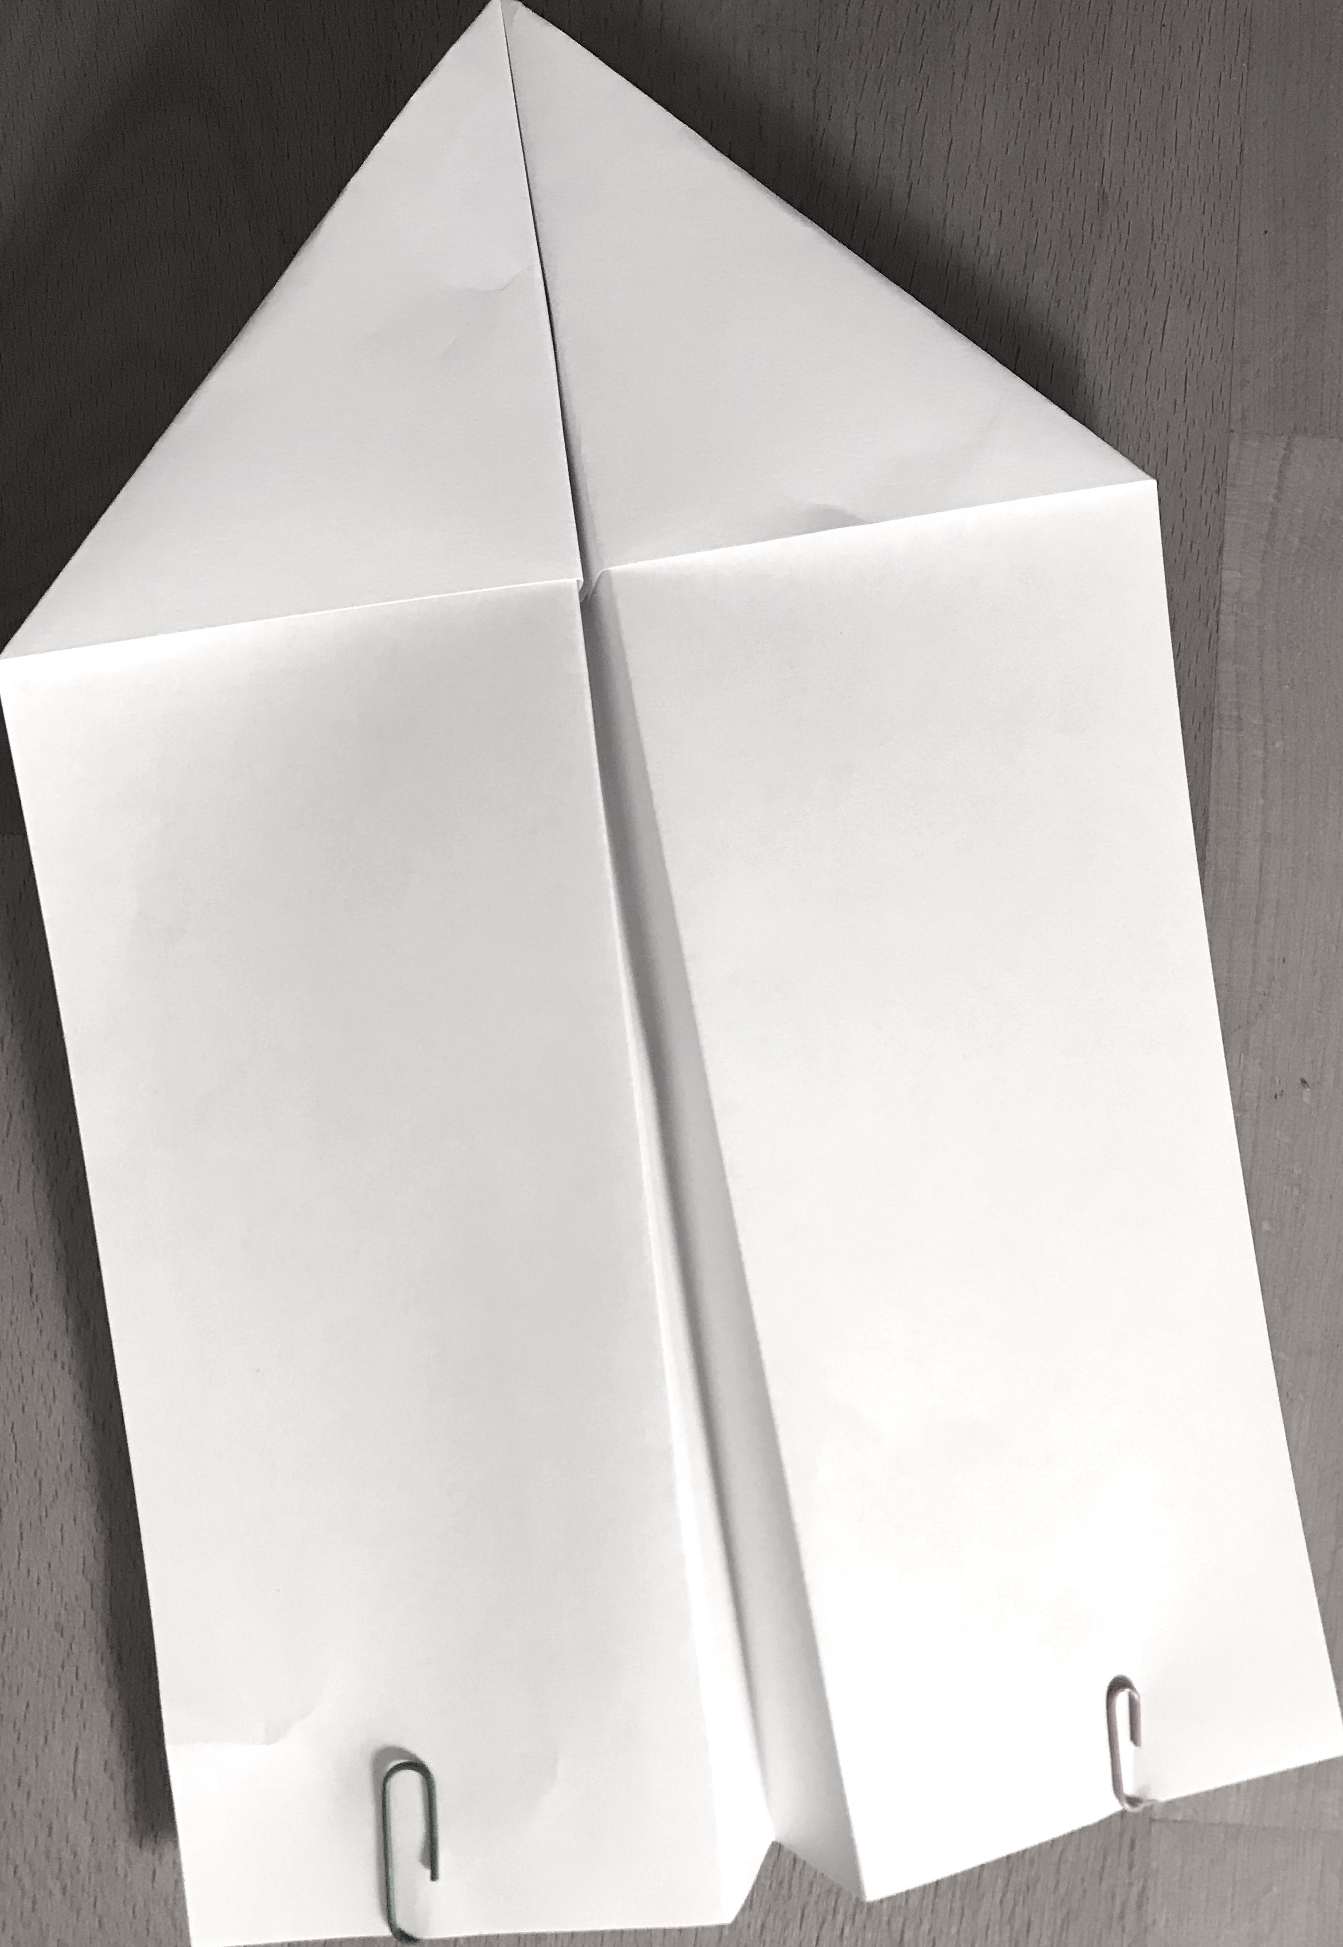
Use this page for building the paper plane.
Place one clip with the smaller arch on the top.
Place 2 clips on the hull.
Place 2 clips on the wings.

Slide 9
Process Overview
KATA Jet
Process:
Observation date:
Observer:
Tim
flight distance is influenced by…
throwing force
launching angle
side view
launching hight
launching position
cross deviation is influenced by…
top view
lateral launching angle

Slide 10
Current Condition of Process Metric
KATA Jet
Process:
Termin:
Indicator (name + unit):
FLIGHT DISTANCE (cm)
Remarks
400
300
200
100
Date

Slide 11
Current Condition of Process Metric
KATA Jet
Process:
Termin:
Indicator (name + unit):
AVERAGE FLIGHT DISTANCE (cm)
Remarks
400
300
239
200
200
211
199
196
100
Date

Slide 12
Current Condition of Process Metric
KATA Jet
Process:
Indicator (name + unit):
FLIGHT DISTANCE _______ to ________

